Slide 1
Automatic Reflection Removal from Photos
Reflections obstruct visibility in photos

Slide 2
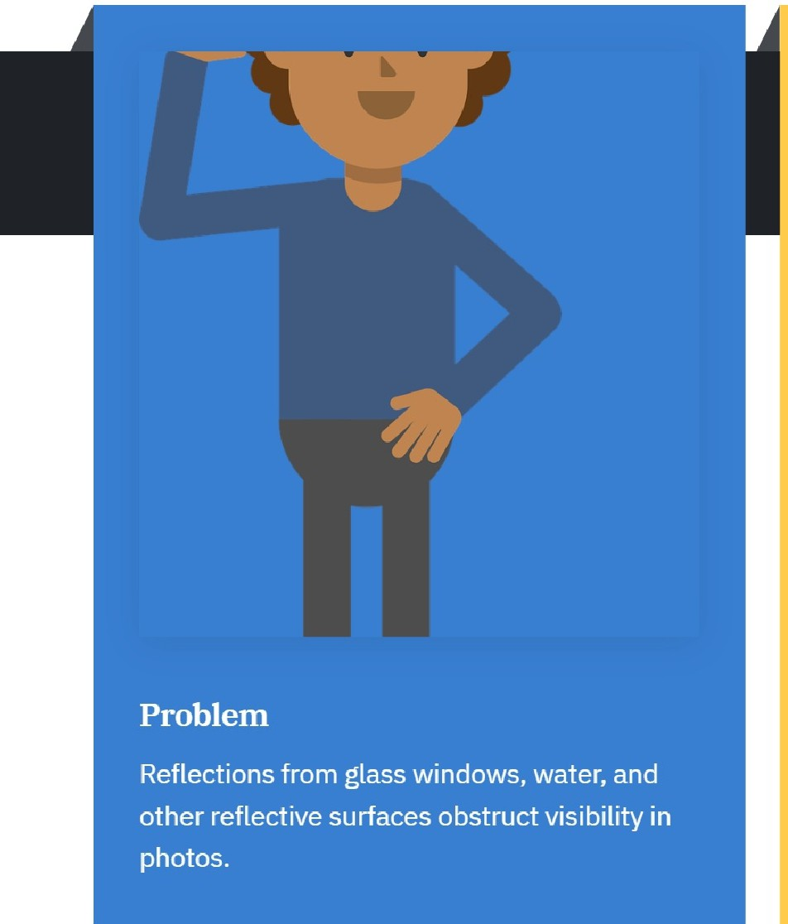


Problem Statement
Impact on Personal Photos
Distorted personal photos resulting from reflections.

Slide 3
Solution Overview
Introducing Reflection Remover AI
Introducing ReflectionRemover AI
Deep learning-based model for automatic reflection removal
Preserves original image quality and details
Effective under various lighting conditions and
■
reflection types
■
This is a groundbreaking solution designed to tackle reflection issues in images.
Utilizes advanced deep learning techniques to automatically eliminate reflections from images.
Ensures that the integrity of the original image is maintained while removing reflections.
Demonstrates high performance across different lighting scenarios and types of reflections.

Slide 4


■
■
Key Features
Advanced Reflection Detection
Identifies reflections using edge detection and image segmentation.
II
Reflection Separation
Separates reflection from the original image using layered representation.
II
m
Image Refinement
Enhances image clarity and removes artifacts.

Slide 5
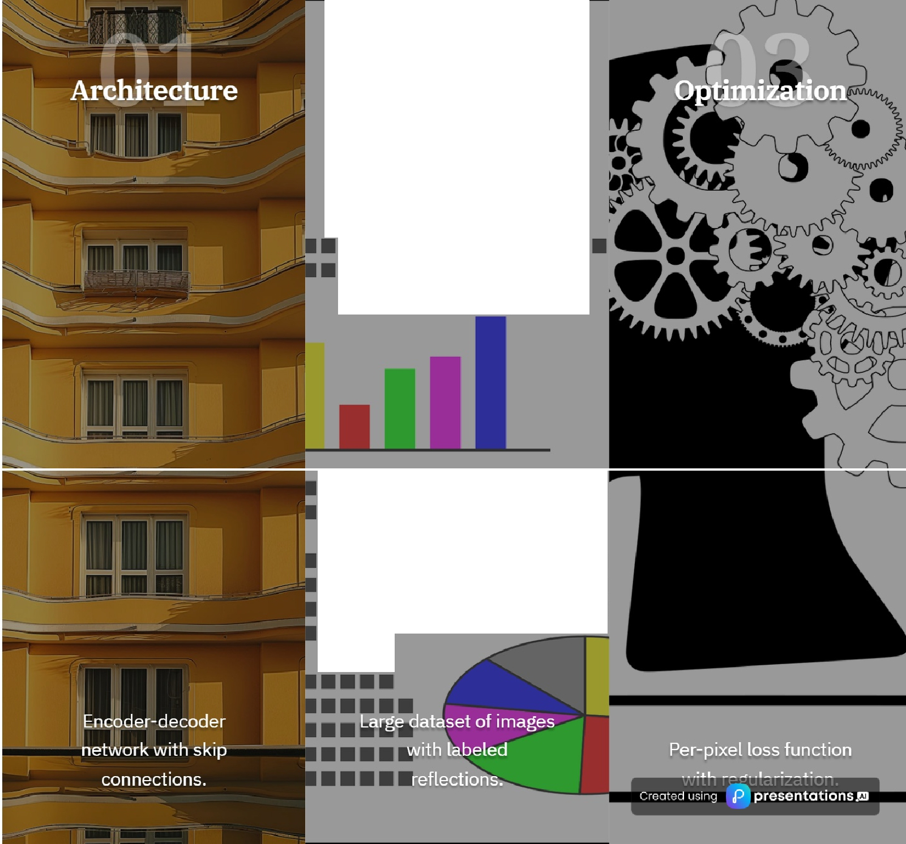

■■■■■
••••••••••••••••••••••••••
Technical Details
•••••••••••••••••••••••••••••
•••••••••••••••
•••••••••••••••••••

Slide 6

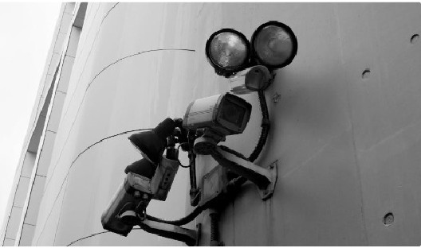
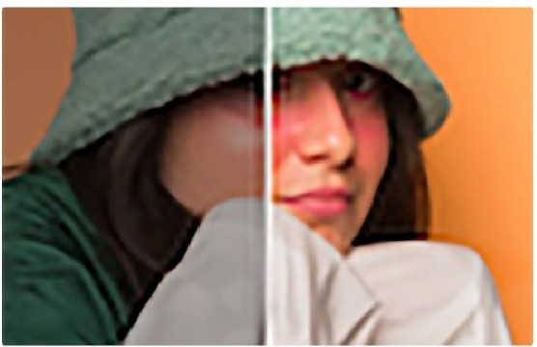

mJ Improved Security Camera Footage
Clear visibility for enhanced security.
1111 Enhanced Personal Photos
Remove unwanted reflections for better memories.
ml Autonomous
Accurate visibility through windows and water.

Slide 7
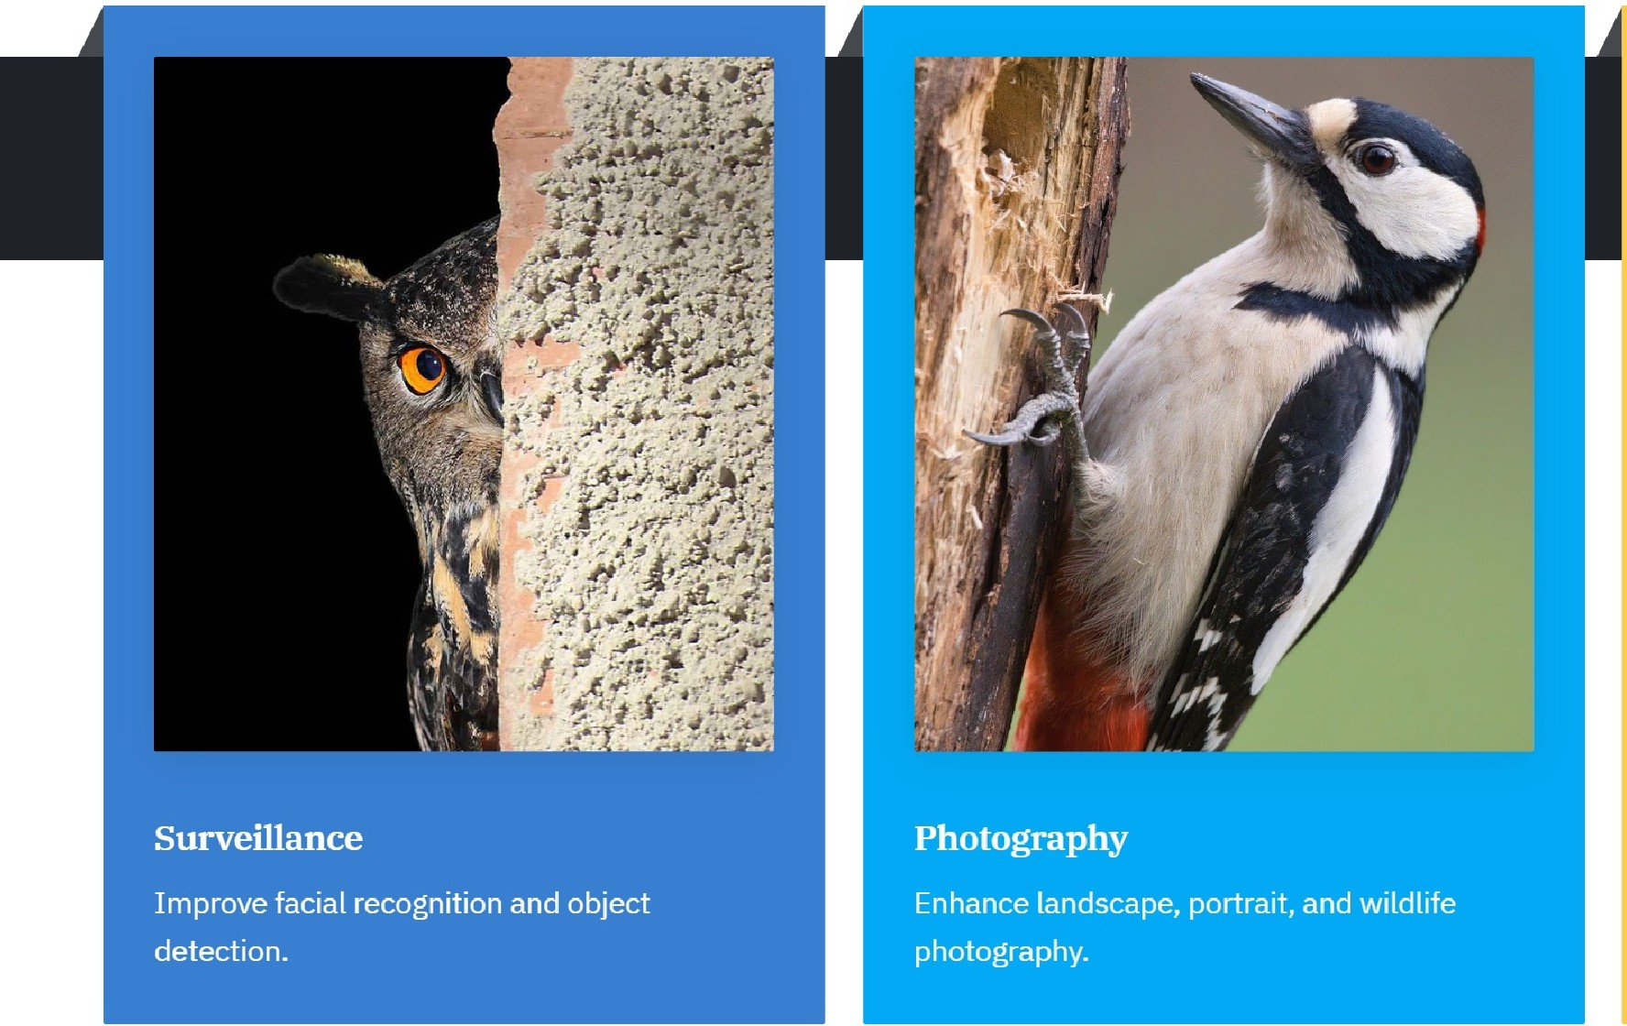

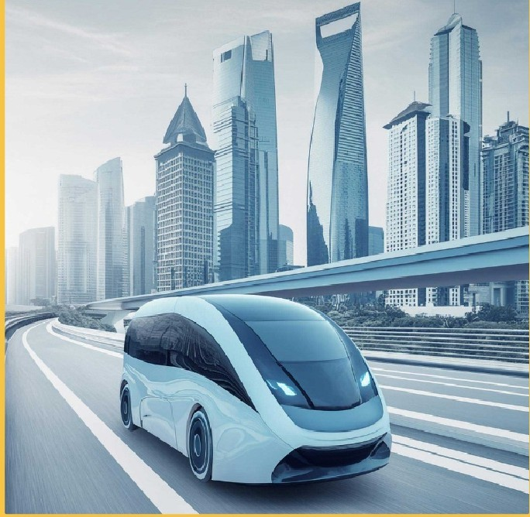
Real-Life Applications
Autonomous
Enable safe navigation through reflective environments.

Slide 8


Im Peak Signal-to-Noise Ratio (PSNR)
Measures image quality.
•
mJ Structural Similarity Index (SSIM)
Assesses similarity to the original image.
ml Mean Opinion Score (MOS)
Subjective evaluation of image quality.

Slide 9

Future Work
Friendly • Flexible • Reliable • Realtime
Scalable

Slide 10
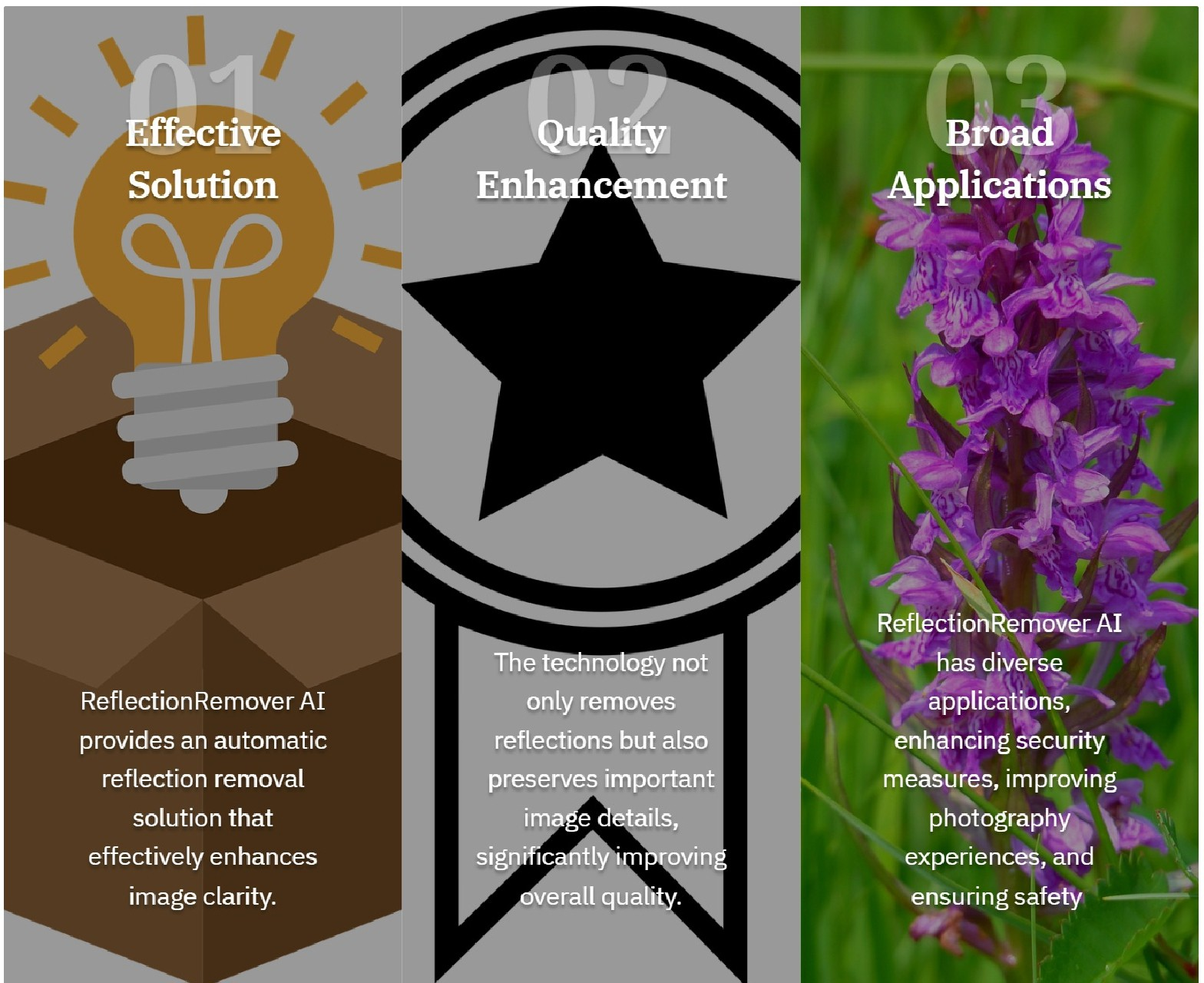
Conclusion
ReflectionRemover AI: Revolutionizing

